Slide 1
Color theory

Slide 2
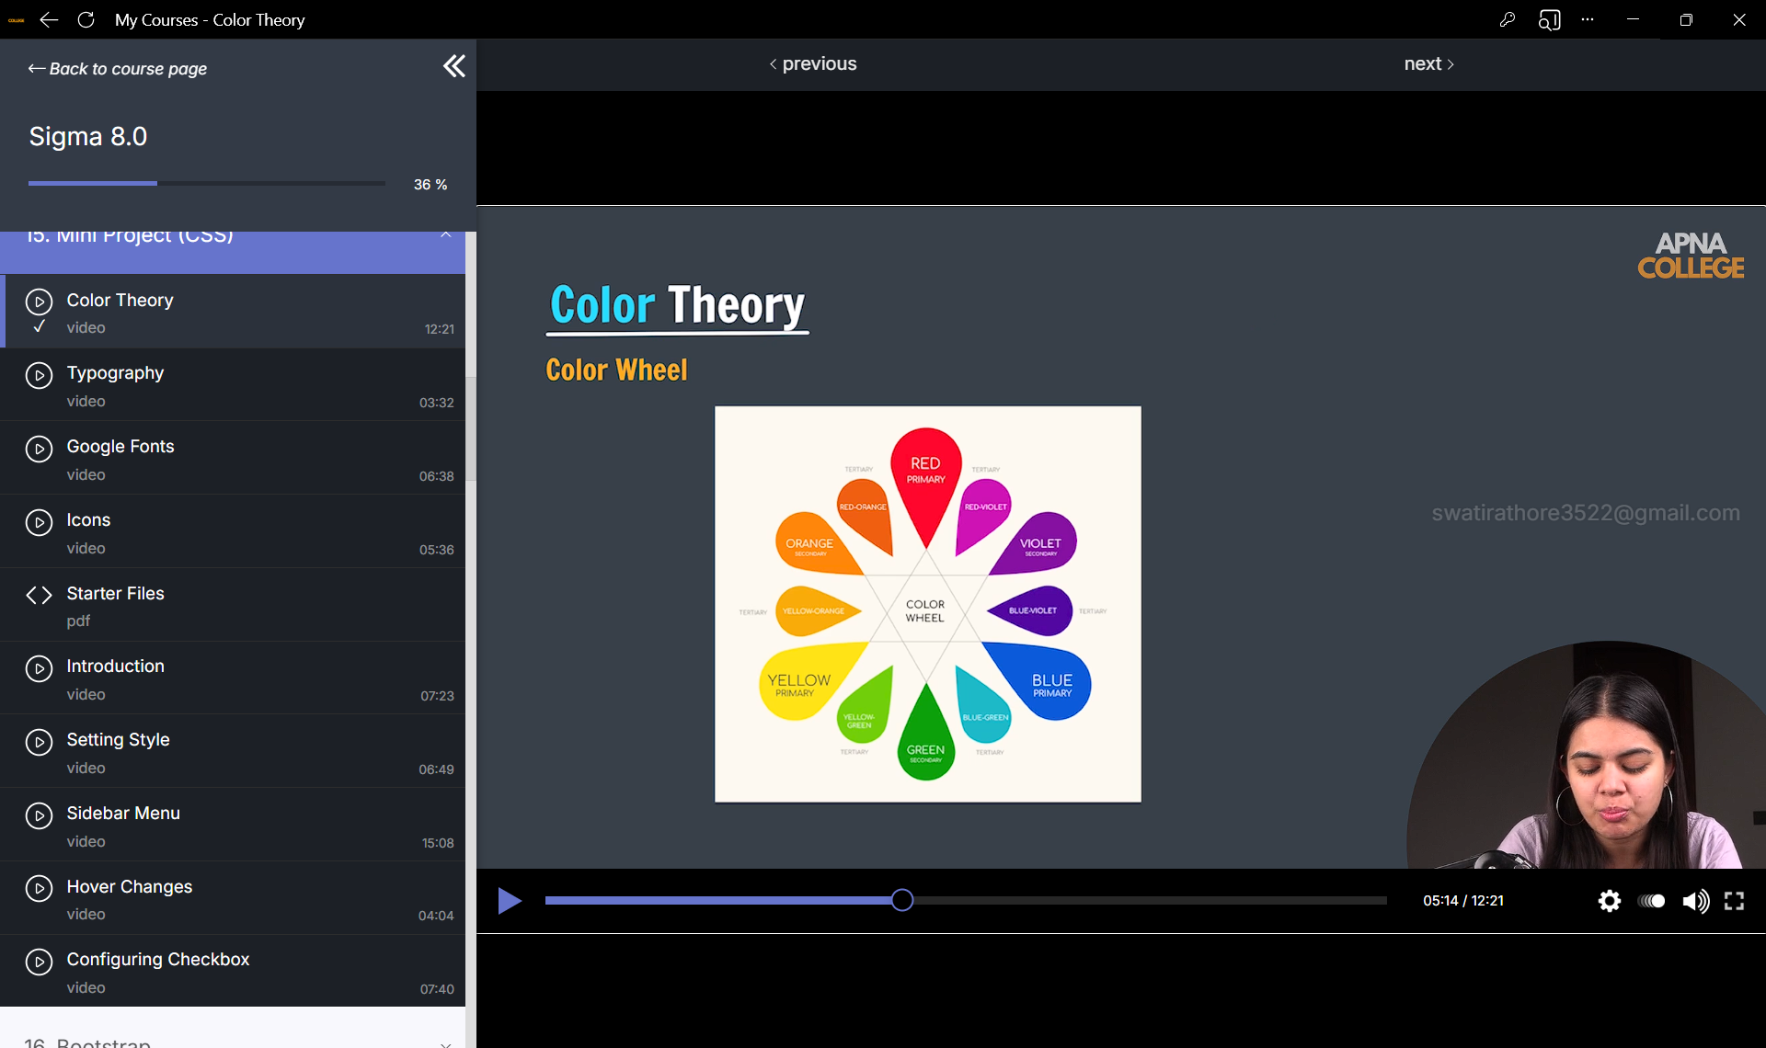

Slide 3
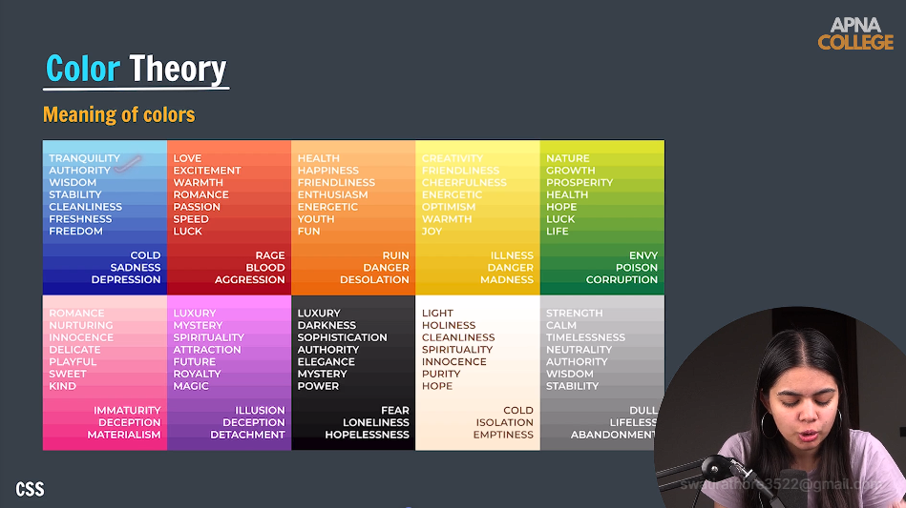

Slide 4


Slide 5
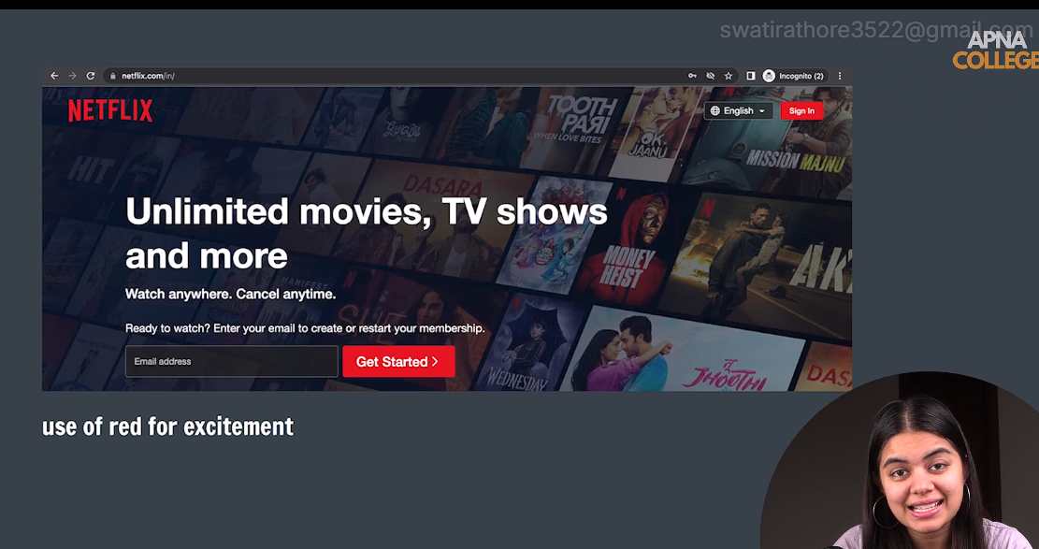

Slide 6
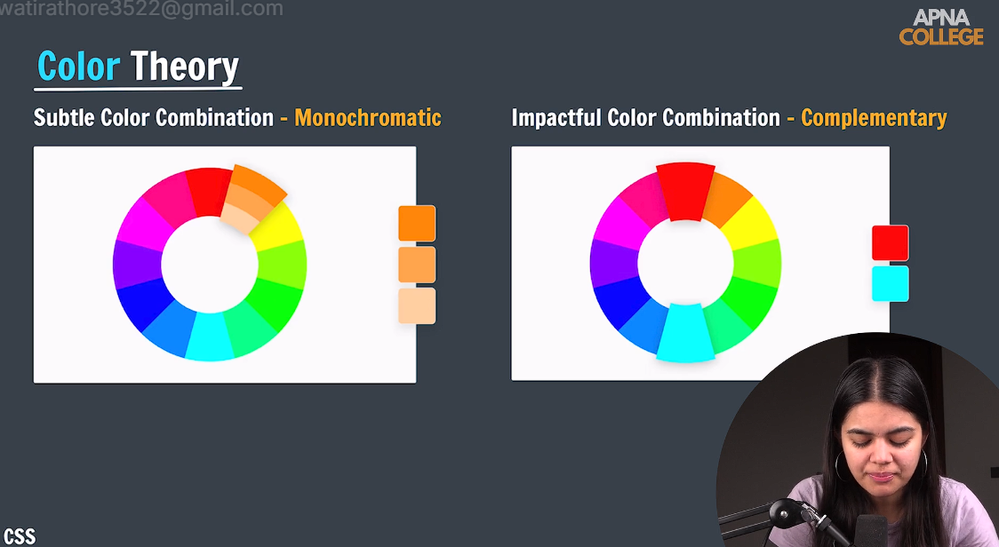

Slide 7
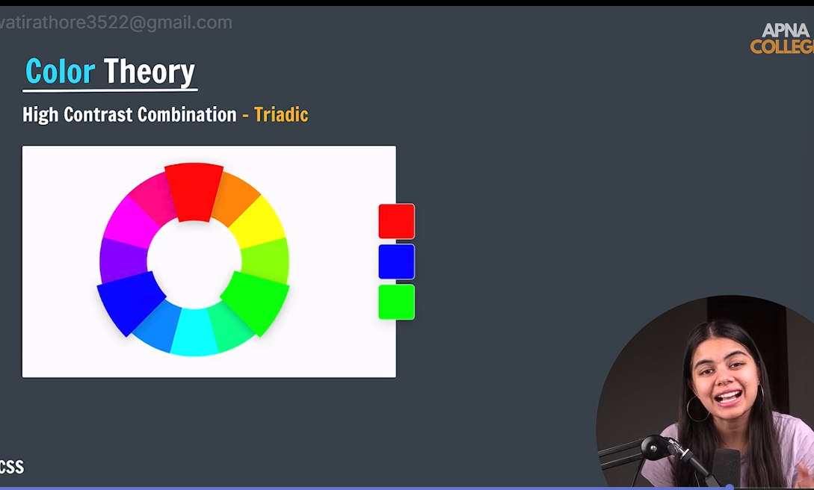

Slide 8
typography

Slide 9
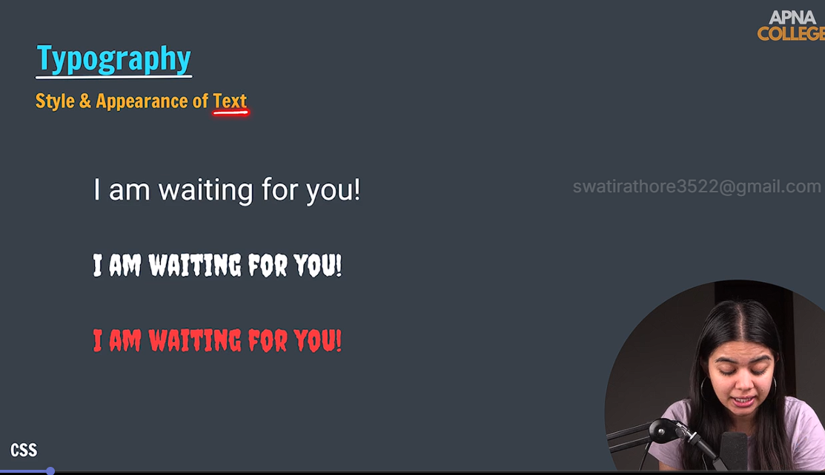

Slide 10
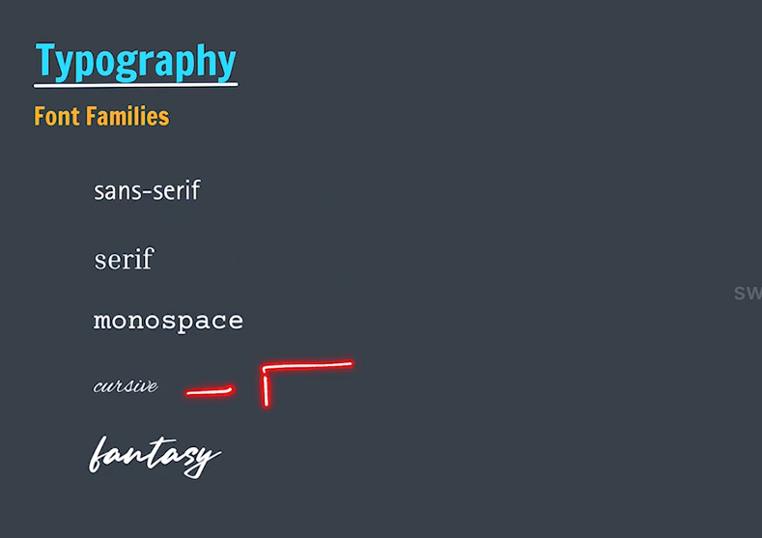

Slide 11
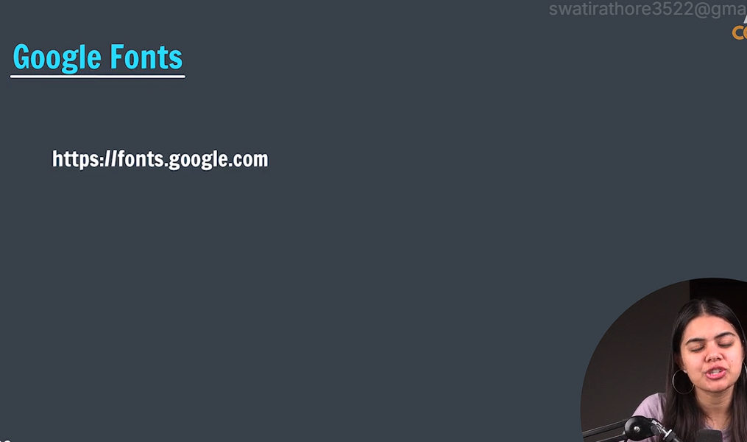
Google fonts
Google fonts par sab dekh sakte hai
1530 available

Slide 12
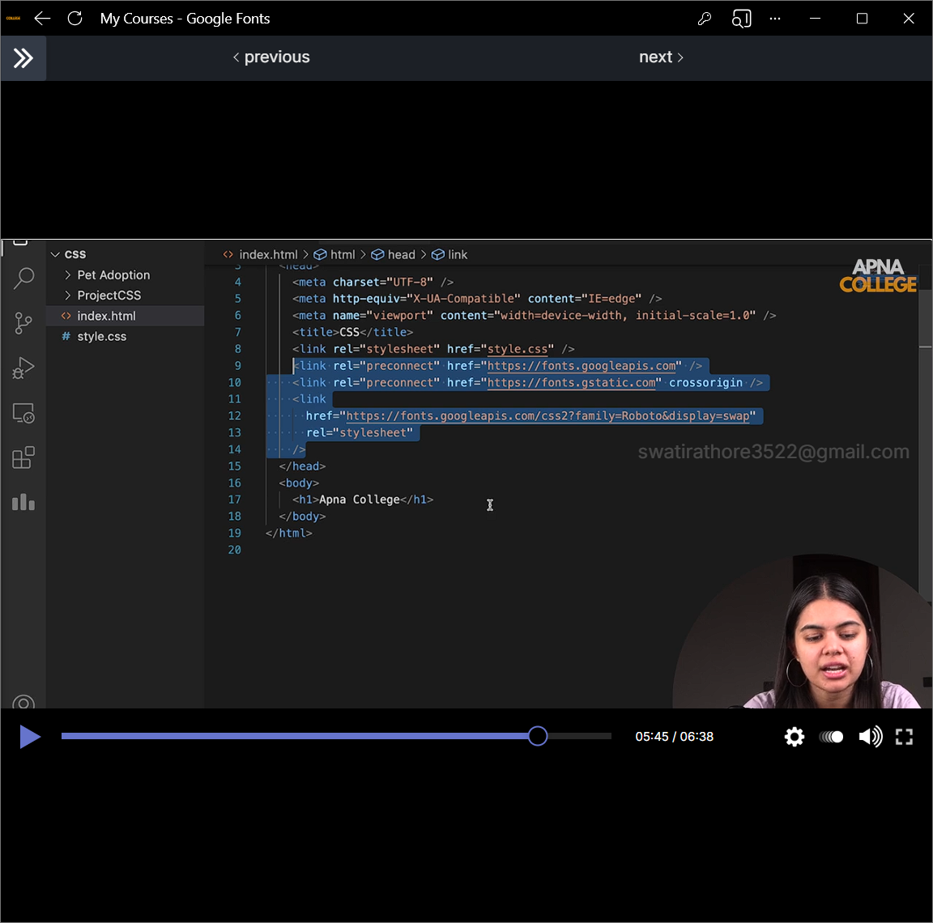
Select fonts from google fonts( take the link)
Do not use heavy fonts as it will lead to heavy html file
Naye naye fonts hum select kar sakte link paste karo html me aur phir jakr css me styling karo according to css rule in google fonts

Slide 13
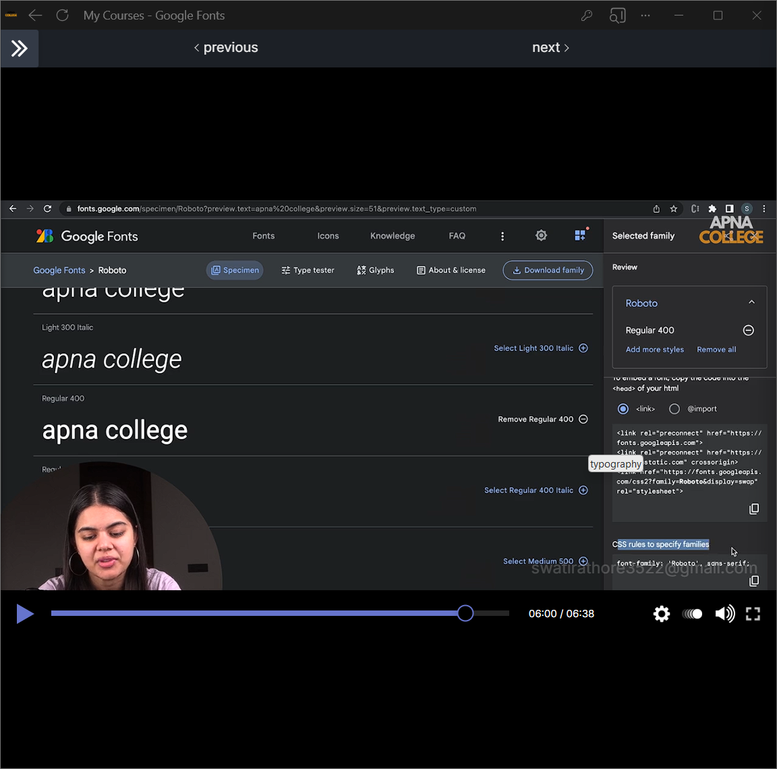

Slide 14
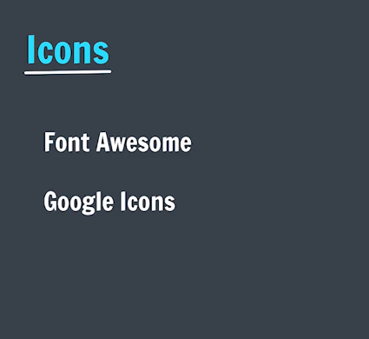
ICONS
Google icons par free milte hai
Link add karuye html me
Font swesome bhi aachi web hai
Cdnjs.com me link milega font wesome se icons llane ke liye

Slide 15
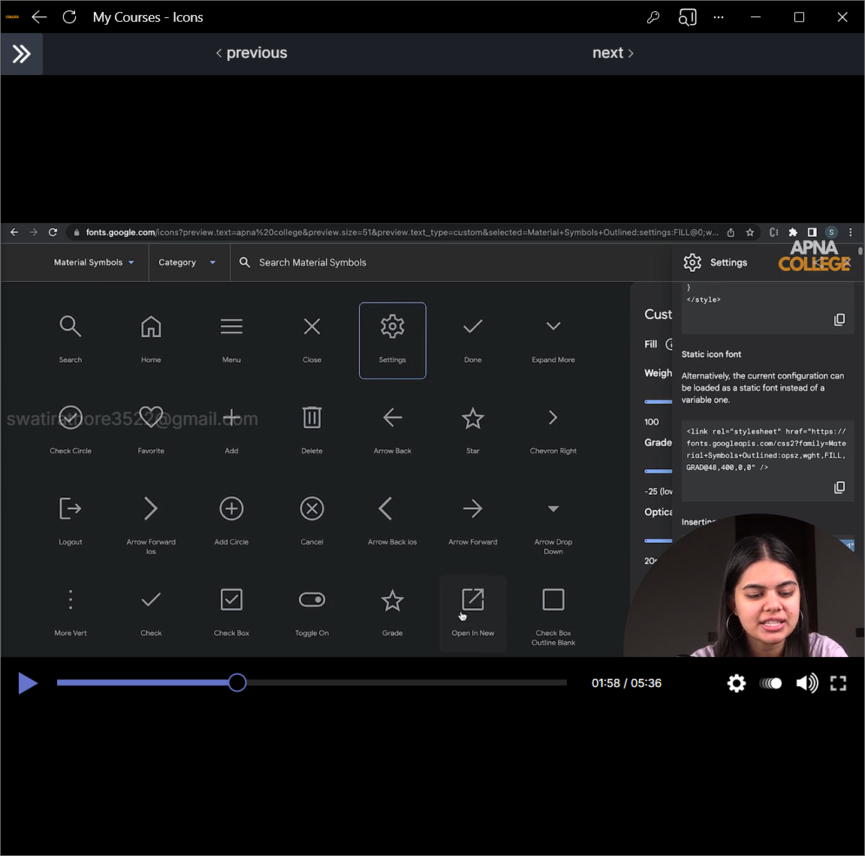

Slide 16
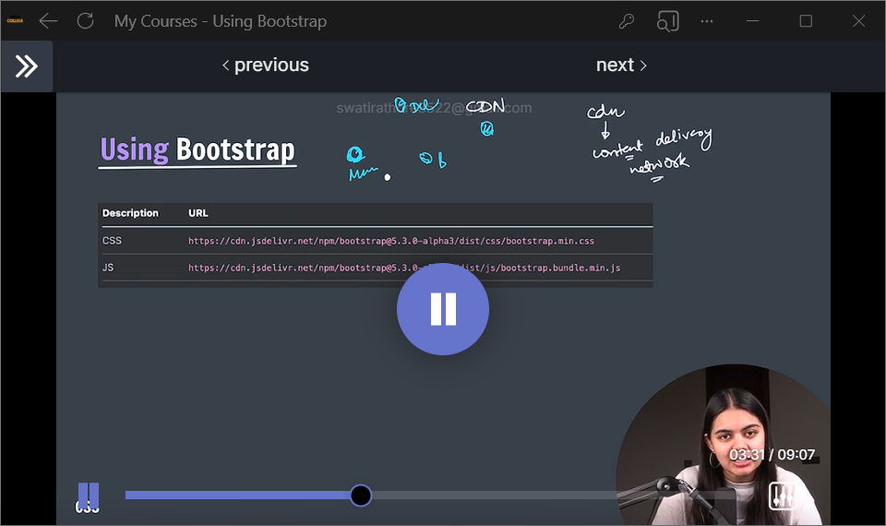
Boot strap

Slide 17
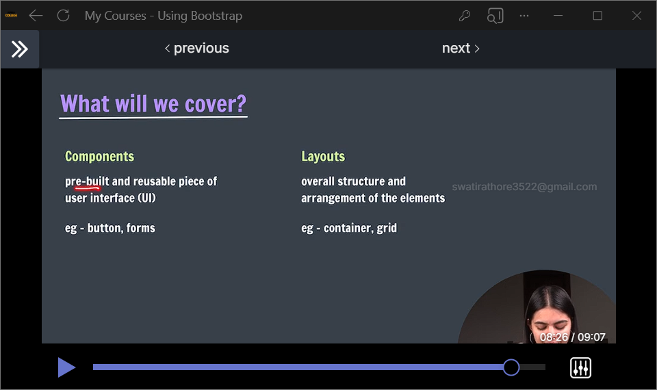

Slide 18
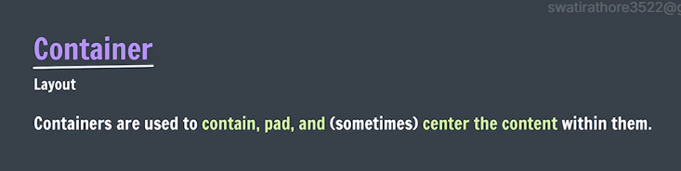
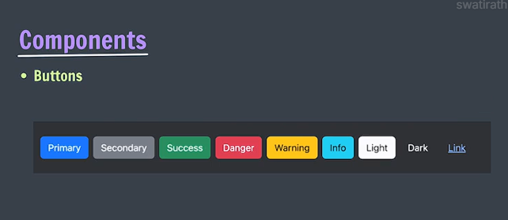
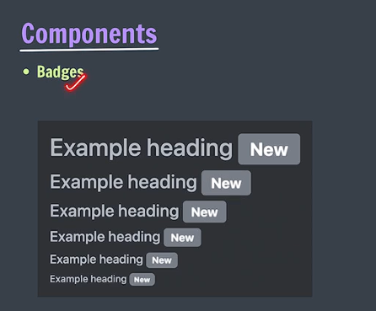
Layout me jakar container click kare
Components me jakr button click kare
Twitter or whtsapp par jo notification par jo number aate hai wo badges hote hai.

Slide 19
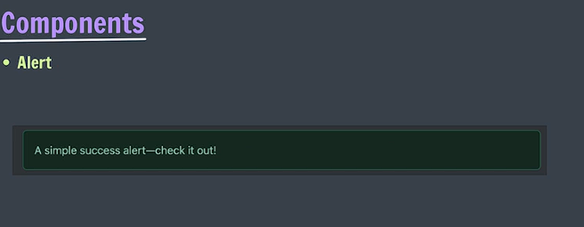
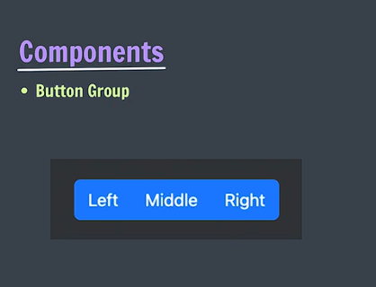
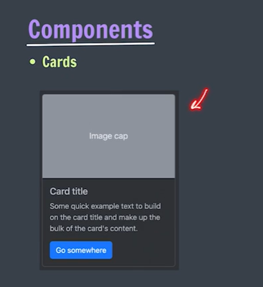
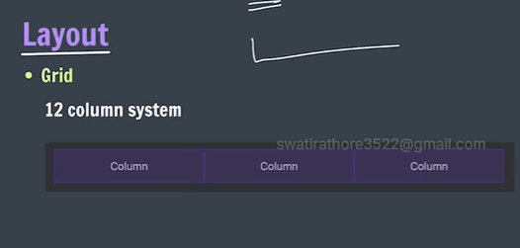
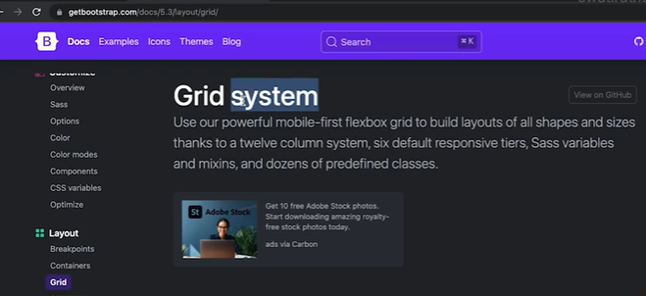
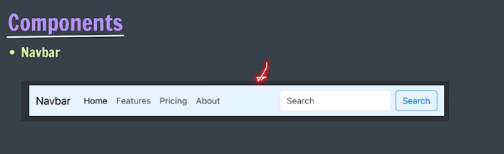
GRID LAYOUT
Ek row 12 columns me decide karte
So 12 units me khelo ki kitne units dene kisiko

Slide 20
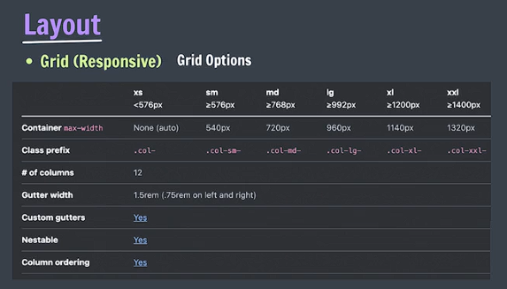
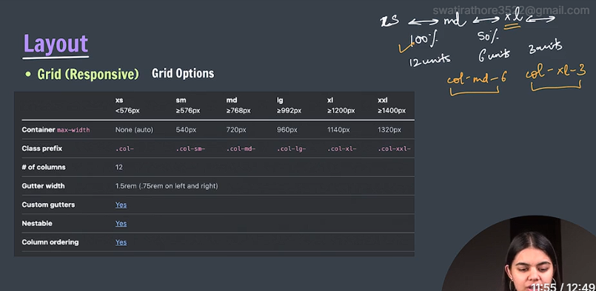
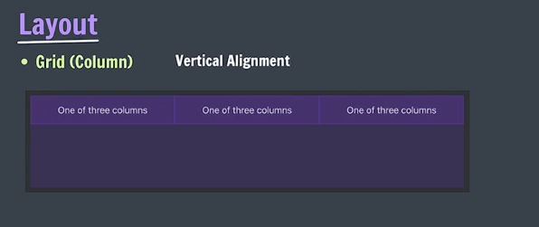


Col-6 ka matlab hai ki xs wale aur use bade wale screensize ke liye ye applicable hoga-yani 6 units occupy Karega xs aur use bade ke liye
Col-md- ka matlab jab tak md hit nhi hota tab tak whi rahega 100% width warna md hit hone ke baad wo 2,8 jo bhi likhoge wo le lega
Grid (vertical alignment

Slide 21
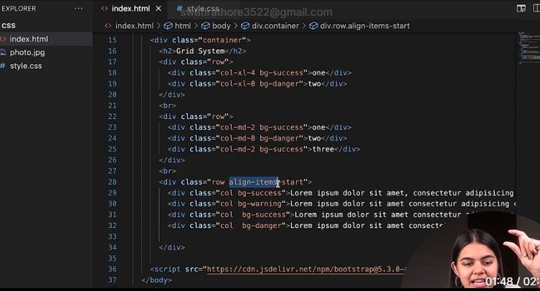
Grid (vertical alignment) continue… centre end jitne bhi flexbox ke item ho wo laga sakte upar neeche karne ko

Slide 22
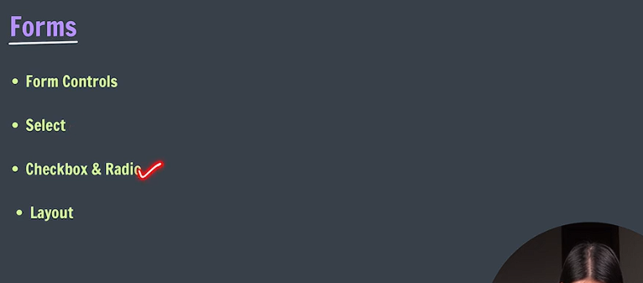
Select in Forms
Checkbox and radio in forms
Form layout

